Slide 1
Object Oriented Analysis and Design for Information Systems: using UML, OCL and IFML for modeling
Prof. Raul Sidnei Wazlawick

Slide 2
Contents
Introduction
Business modeling
High level requirements
Use case based project planning
Expanded use cases
Conceptual modeling – fundamentals
Conceptual modeling – patterns
Functional modeling with OCL contracts
Domain tier design
Code generation
Test
Interface tier design
Data persistency

Slide 3
Conceptual model
Attributes:
simple alphanumeric or primitive information, such as numbers, texts, dates, etc. An attribute is always connected to a more complex element: the concept.
Concepts:
the representation of the complex information that has coherent meaning in the domain. Concepts usually aggregate attributes and cannot be described merely as alphanumeric. Concepts also may be associated to each other.
Associations:
a kind of information that links different concepts. However, associations are more than mere links: they are information.

Slide 4
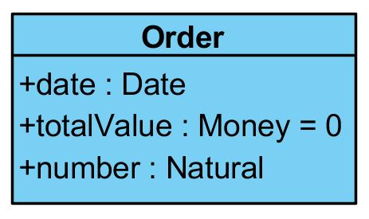
Valor inicial de atributo
Context Order::totalValue:Money
init: 0
Context Order::totalValue
init: 0

Slide 5
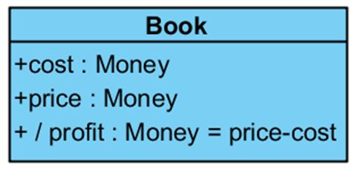
Atributo derivado
Context Book::profit
derive:
self.price-self.cost
Context Book::profit
derive:
price-cost

Slide 6
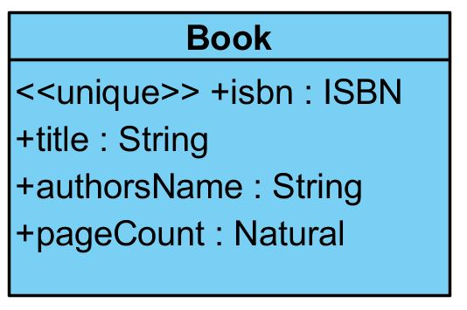
Unique attributes

Slide 7

Derived association
A customer indirectly associated to books

Slide 8
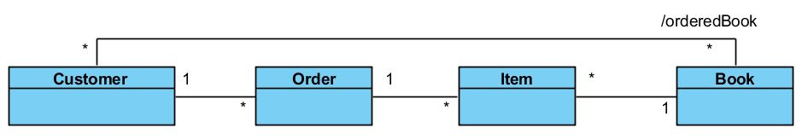

Derived association

Slide 9
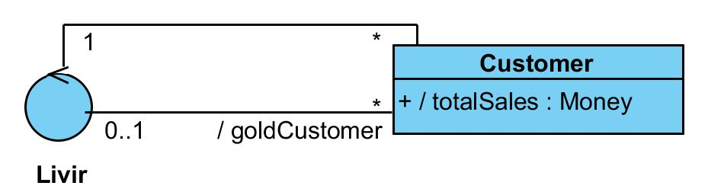


Derived association defining a subset of a normal association

Slide 10
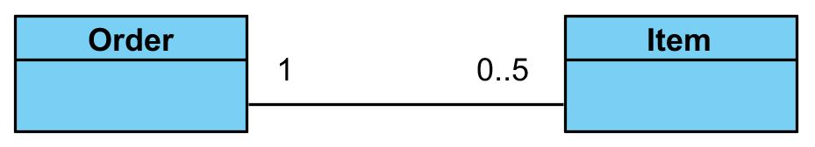
Implicit invariant

Slide 11
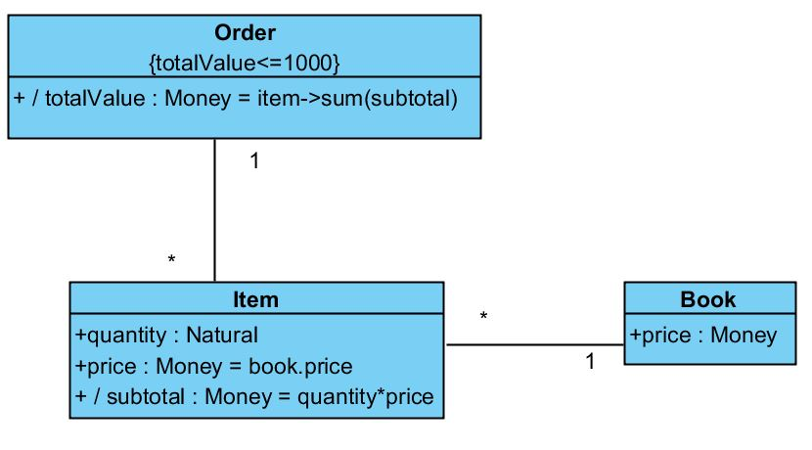
Invariant

Slide 12
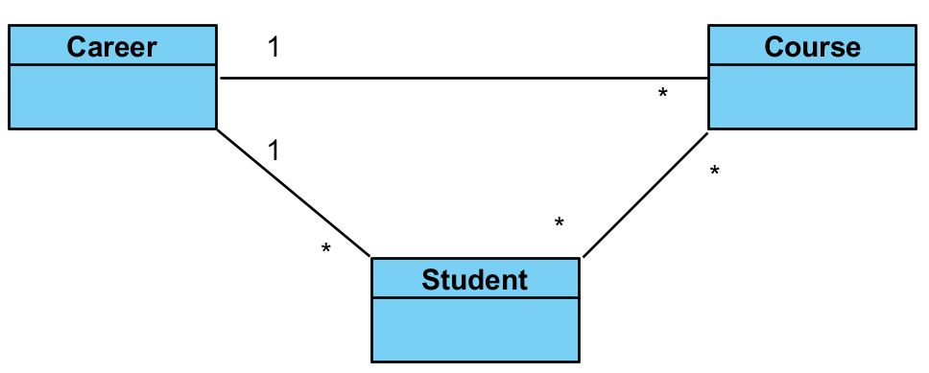

Invariant

Slide 13
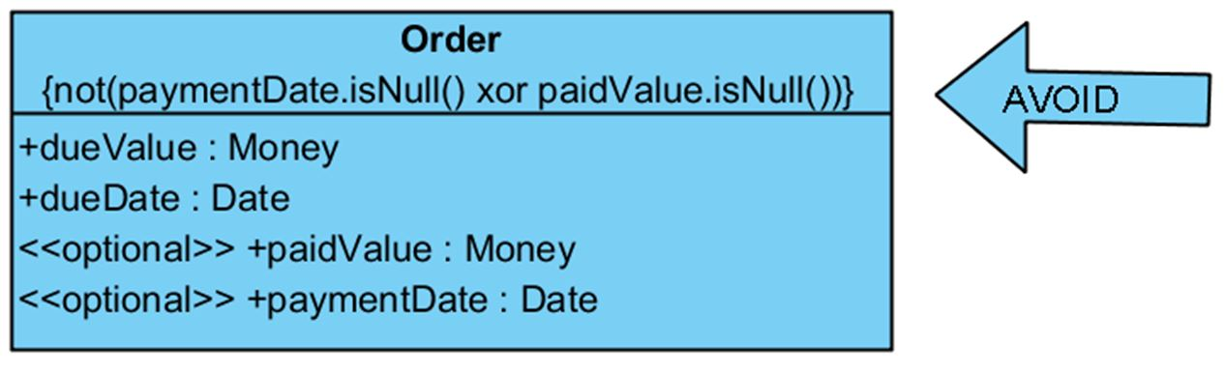
A class with low cohesion for having attributes depending on each other

Slide 14
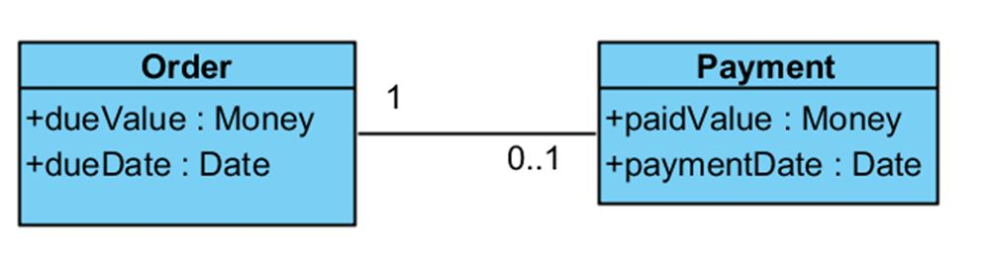
A modeling solution with high cohesion classes

Slide 15
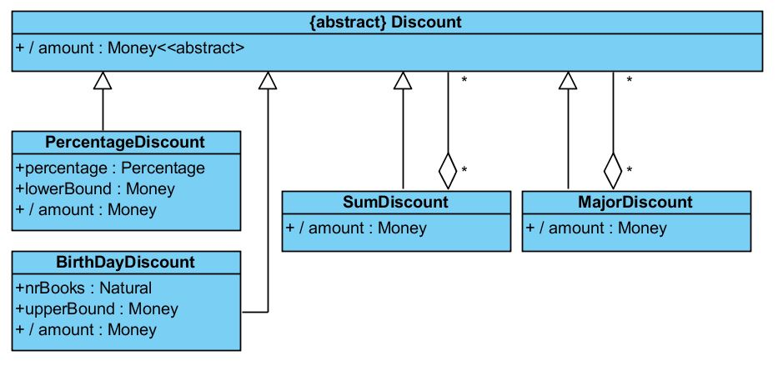
Example of the Composite pattern

Slide 16
Context SumDiscount::amount:Money
derive:
self.discount->sum(aDiscount|aDiscount.amount)

Slide 17
Context MajorDiscount::amount
derive:
self.discount->maxElement(aDiscount|aDiscount.amount)

Slide 18
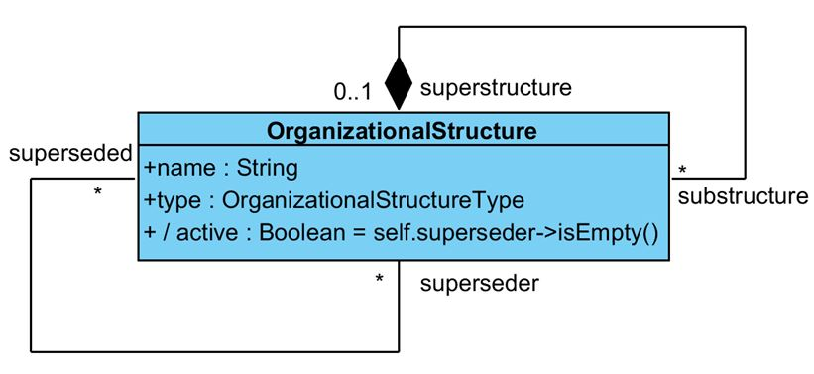
Superseding

Slide 19
Classes for the pattern Transaction/Account
Context Account::balance
derive:
entry->sum(value)
Context Transaction
inv:
entry->sum(value)=0

Slide 20
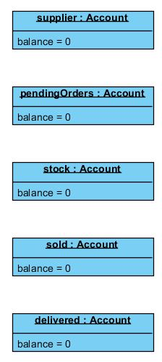
Initial state of an accounting system for products

Slide 21
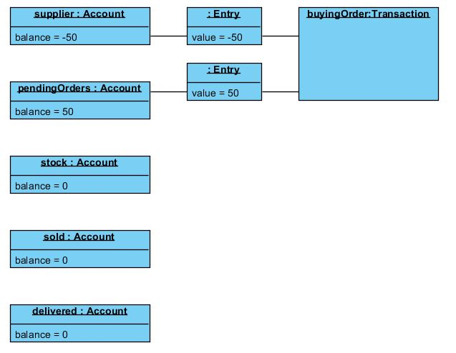
State of the accounts after a buying order of 50 books is issued

Slide 22
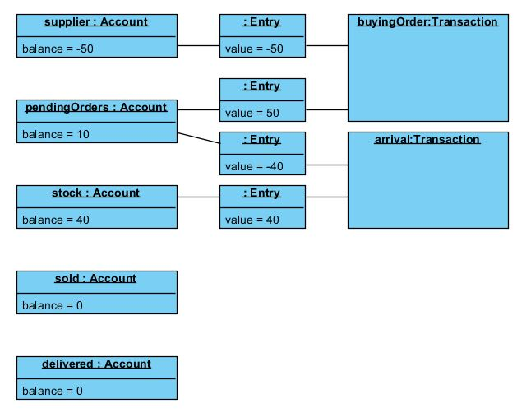
State of the accounts after 40 books arrive at the bookstore

Slide 23
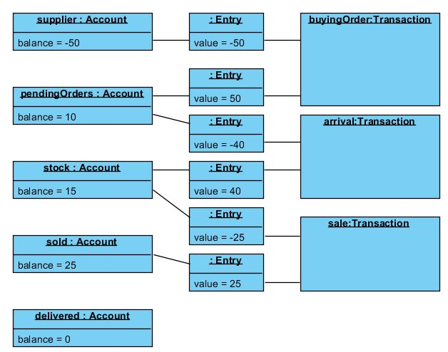
State of the accounts after 25 books are sold

Slide 24
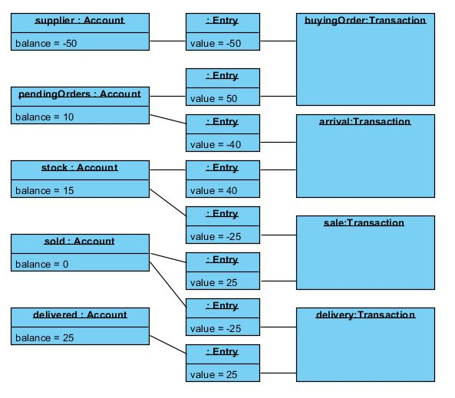
State of the accounts after the delivery of 25 books

Slide 25
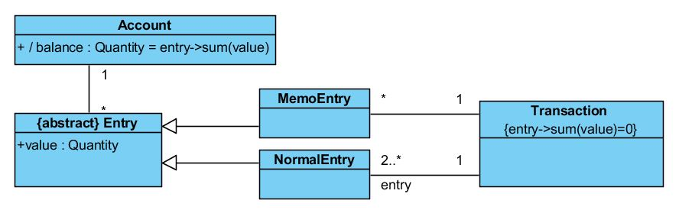
Evolution of Account/Transaction with memo accounts

